Slide 1

讓 AI 為人們所用
Microsoft AI 大藍圖
Eric ShangKuan
Sr. Technical Evangelist
Microsoft Taiwan

Slide 2
Agenda
Microsoft AI 平台概觀
Microsoft Cognitive Services 認知服務
新一代 Azure Machine Learning Services
(Break)
使用 Microsoft Cognitive Toolkit (CNTK) 開始深度學習
Hands-on Lab

Slide 3
Microsoft AI 平台概觀

Slide 4


AI SOLUTIONS
Machine Learning
Pattern Analysis & Recognition
Planning & Scheduling
Natural Language
Vision
Robotics
Swarms & Self-organising Systems
Knowledge Representation & Reasoning
Speech Recognition
Autonomous Systems
AdobeStock Standard License

Slide 5
Microsoft – Democratizing AI
提供給所有個人與組織所用
數位助理
應用程式
服務
平台
Cortana
Office 365
Dynamics 365
SwiftKey
Pix
Customer Service and Support
Skype
Calendar.help
Cortana Intelligence
Cognitive Services
Bot Framework
Cortana Devices SDK
Cognitive Toolkit
Azure Machine Learning
Azure N Series
FPGA

Slide 6
Microsoft Azure + AI 解決方案
快速與彈性 全方位資料平台 企業級解決方案
DATA GRAPHS
AZURE + AI
智慧數位助理
Cortana
Office 365
LinkedIn
Bing
資料平台
Azure Data Lake
Azure Cosmos DB
SQL Server
基礎環境
Azure Batch AI Training
FPGA/GPU
感知服務
Cognitive Services
具備 AI 應用程式
Office
Windows
Dynamics
工具
Visual Studio | Azure Machine Learning | Bot Framework
Cognitive Toolkit | TensorFlow | Caffe

Slide 7
微軟人工智慧相關服務與基礎環境
Microsoft Cognitive services
Bot framework
開發人員可直接叫用之人工智慧 API
資料科學家使用之工具
– Azure Machine Learning, Microsoft R Server
資料科學家互動式工具驗證機器學習模型
深度學習，機器學習底層演算法工具
– Microsoft Cognitive Services Toolkit, TLC
微軟開放自己使用之深度學習與機器學習基礎環境
資料資產
Big Data 資料分析工具 – Azure HDInsight, Azure Data Lake
微軟開放自己使用之深度學習與機器學習基礎環境
海量級硬體運算創新 (Scale, GPU, FPGA) – Azure 運算資源
雲端用之不盡之運算資源

Slide 8


Bringing intelligence to where data lives
Application
Application + Intelligence
VS
Database
Intelligence + Database
Regular Database + App
Intelligence Database + App
Notes:
We are innovating on running algorithms close to where the data lives – so you can easily build fast, large scale, compliant and secure AI, without the latency of large scale data movement.
Why? In the past, a common application pattern was to build and host statistical and analytical models and business logic outside the database, in the application layer or in specialty statistics tools.
This meant that the application layer had to perform a lot of heavy lifting.
Fast data extraction, concurrency, high availability, resource management, security, access control, compliance, manageability… A lot of heavy lifting.
But a modern commercial database gives you all that built-in. It already does that heavy lifting.
We are bringing the ability to run machine learning and AI in a performant multi-threaded, distributed way at scale directly in the database.
This includes the Microsoft Machine Learning algorithms grown from Microsoft’s leading AI research, and even the latest in open source such as R & Python.
Now you can build enterprise grade intelligent applications in a far simpler way.
And this is available to you both on-premises and in the cloud.
No one but Microsoft can do this for their customers.

Slide 9



SQL Server 2017
Run anywhere and build apps using the language of your choice
Analyze complex relationships with support for graph data
Advanced Machine Learning with R & Python
Unparalleled performance with adaptive query processing
SQL Server 2017
Industry-leading performance on the most secure data platform, with built-in intelligence for all your data
Notes:
SQL Server 2017 provides intelligence, on a trusted industry-leading, most secure data platform, and enables innovation for all your data
It enables you to engage market leading solutions for every workload including Advanced Analytics, Business Intelligence, Data Warehousing and OLTP
It has the most advanced Machine Learning with R & and now Python.
It has unparalleled performance with enhancements to its in-memory technologies and adaptive query processing
It continues to better secure your data with layers of protection or security-in-depth philosophy, and innovative security features like Always Encrypted
It can analyze even more complex relationships with support for graph data
It’s on Windows and Linux.
And because it does all this in a single SKU – no add-ons to but – it does so with unmatched TCO.

Slide 10




SQL Server 2017
Industry-leading performance on the most secure data platform, with built-in intelligence for all your data
Fastest performance
Most secure
Real-time intelligence
For all your applications
#1 in TPC-E, TPC-H
Least vulnerable for
the last 7 years
Up to 1M predictions/second
Any data, any platform, any language
#1
Native R and Python integration
Java, PHP, node.js, .NET
Most consistent experience from on-premises to cloud
Unmatched TCO with everything built-in
The above graphics were published by Gartner, Inc. as part of a larger research document and should be evaluated in the context of the entire document. The Gartner document is available upon request from Microsoft. Gartner does not endorse any vendor, product or service depicted in its research publications, and does not advise technology users to select only those vendors with the highest ratings or other designation. Gartner research publications consist of the opinions of Gartner's research organization and should not be construed as statements of fact. Gartner disclaims all warranties, expressed or implied, with respect to this research, including any warranties of merchantability or fitness for a particular purpose.
National Institute of Standards and Technology Comprehensive Vulnerability Database update 2/2017.
Notes:
Power your entire data estate with SQL Server 2017
Now we’ll look at all the reasons why SQL Server is the right database for your on-premises data estate.
Data Management - TDM
SQL Server is no longer just an OLTP database, it’s a mission critical OLTP database with industry-leading TPC-E performance benchmarks. It has been recognized by Gartner as a leader in Operational Database Management four years in a row, and THE leader in this quadrant for the last two years.
When it comes to data warehousing, you used to only be able to handle small data marts in older SQL Server versions. Today we have companies like NASDAQ who are doing petabyte scale data warehousing in a scale up SMP architecture just with SQL Server. Not to mention we have can support MPP architecture as well for very large data warehousing workloads. That’s tremendous value coming out of one enterprise SKU.
<click>
Data Sources
SQL Server 2017 not only has the great PolyBase technology for querying across structured data in SQL and unstructured data in Hadoop that we introduced in SQL Server 2016:
It now can handle even more types of data, with the introduction of graph data management and graph analysis to handle new, non-hierarchical relationships among your data.
<click>
Data Insights - BDM
BI (business intelligence) is an area in which everyone gave us lots of feedback, so we invested in it in a big way in the last release, SQL Server 2016. We’ve did a complete overhaul of SQL Server reporting services, refreshing to a modern report interface and adding new chart types like tree and sunburst.
And on top of that, we delivered an end-to-end mobile BI solution that not only works on Windows but also iOS, works on Android and, and beauty is it works online and offline. So it’s a comprehensive solution again being delivered out of that one SKU.
And if you choose to use Power BI, our cloud-based business analytics service that enables anyone to visualize and analyze data with greater speed, efficiency, and understanding, you can connect users to a broad range of live data through easy-to-use dashboards, interactive reports, and compelling visualizations –all at a fraction of the cost of our competitors.
And in SQL Server 2017, we have added many enhancements to SQL Server and analysis services (SSAS) as well, enabling you to mash up data from many sources,
In today’s world, businesses are trying to get predictive. Instead of reacting to data they want to pave their business path forward with data. The way to do that is with advanced analytics. From predicting optimal warehousing to sales forecasting to customer behavior, customers want to build predictive models based on data. And with SQL Server, you don’t have to take data out of the database to do advanced analytics. With Microsoft’s Machine Learning Services, you can do R and Python-based analytics, at scale and in a highly parallelized way, right in the database for Real time analytics at up to 1M predictions per second.
<click>
Data Security
Now let’s talk about security. You can see why we are saying we are the most secure database. This is from NIST, National Institutes of Standards and Technology and over the last seven years, SQL Server has least vulnerabilities of any database tracked by NIST. You can see the bars there with our number of incidents compared to competitors: Less than SAP HANA, which has only been tracked for half of those years. Less thank Postgres. Less than DB2. Far less than Oracle and MySQL.
<click>
Flexibility
Now that you see the scope of what SQL Server can address from a workloads perspective, also that only Microsoft can provide a consistent experience for all these workloads, from on-premises to the cloud, with applications in any language, and across platforms including Windows, Linux, and Docker. Any language, any platform, anywhere.

Slide 11
Supports Graph objects & Graph queries to analyze complex relationships
Adaptive query processing learns & optimizes for unparalleled performance
Python and R support
Advanced ML + Deep Learning on GPUs
SQL Server 2017
Industry-leading performance on the most secure data platform, with built-in intelligence for all your data
Notes:
Graph processing is important for fraud detection, social network analysis and modeling IoT networks. The next version of SQL Server will support Graph objects & Graph queries to efficiently model and analyze such data.
Adaptive query processing learns from prior query executions and optimizes for the best performance.
We’ve made some incredible strides in extensibility in SQL Server. It now supports executing Python and a query can even mix R and Python code. You can install your own python packages and run arbitrary analytic computations close to the data.
Finally, we have made some incredible advances in incorporating AI into SQL Server. We have added in some of Microsoft’s most advanced ML algorithms into SQL Server. And it can run most open source Deep Learning algorithms with GPU support.

Slide 12




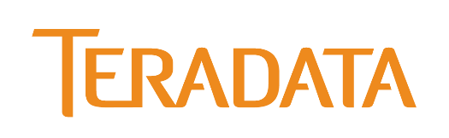

R Server 9.1
Scalable R based machine learning
Pre-trained cognitive models
GPU powered Deep Learning
Enterprise Grade support and operationalization
{ }
R
Combines the best of open source and Microsoft innovation
Notes:
R Server 9.1
With the release of R Server 9.1, we’re going a step ahead by bringing by bringing intelligence to anywhere your data lives – Hadoop/Spark & Teradata in addition to SQL. With R Server 9.1 we are introducing pre-calibrated models and adding support for small data/many models.

Slide 13
Keeping your data safe
Activity monitoring
SQL Database threat detection
SQL Database auditing
Access control
Azure Active Directory authentication
Row-level security
Dynamic data masking
SQL
Data protection
Always encrypted
Transparent data encryption
Notes:
We are embedding machine learning directly into our cloud services to deliver intelligent data services that keep your data safe. For example, consider the security features in Azure SQL DB
Our ML systems analyze and learn from over 700 TB data/per day to ensure we keep your applications highly efficient and data safe – through automatic auditing and threat detection. With active Threat Detection, the service can identify anomalies in your workload and alert you of a potential attack like SQL injection. The service does the hard work so you don’t have to – so you can focus on the business problems you’re solving and creating breakthrough applications.
In addition to automatic threat detection, Azure AD authentication provides an alternative to SQL Authentication. It simplifies password management by allowing you to connect to a number of Azure services including Azure SQL Database using the same identity.
Row-Level Security allows access to rows of data based on a user’s identity, role memberships, or query execution context.
Dynamic Data Masking lets you define masking patterns on database columns to limit the exposure of sensitive data.
<Transition>: Let me show you how easy it is to turn on auditing and threat detection in Azure SQL Database.

Slide 14
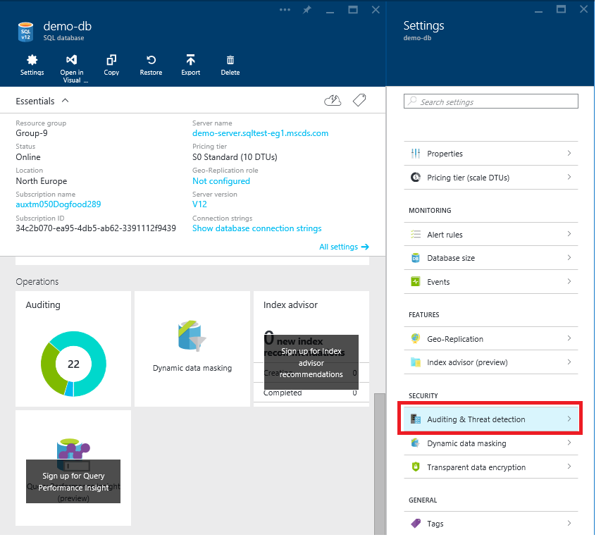
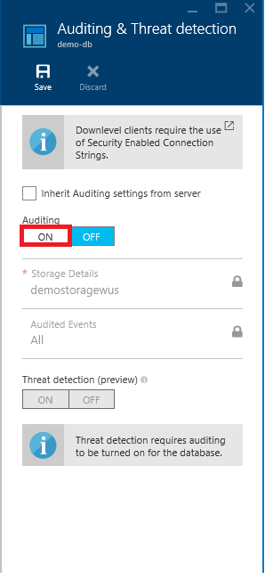
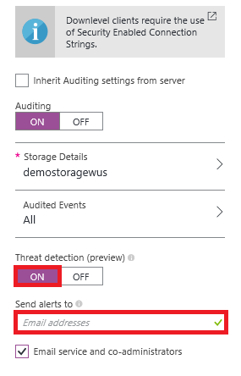
Machine learning based threat detection

Slide 15
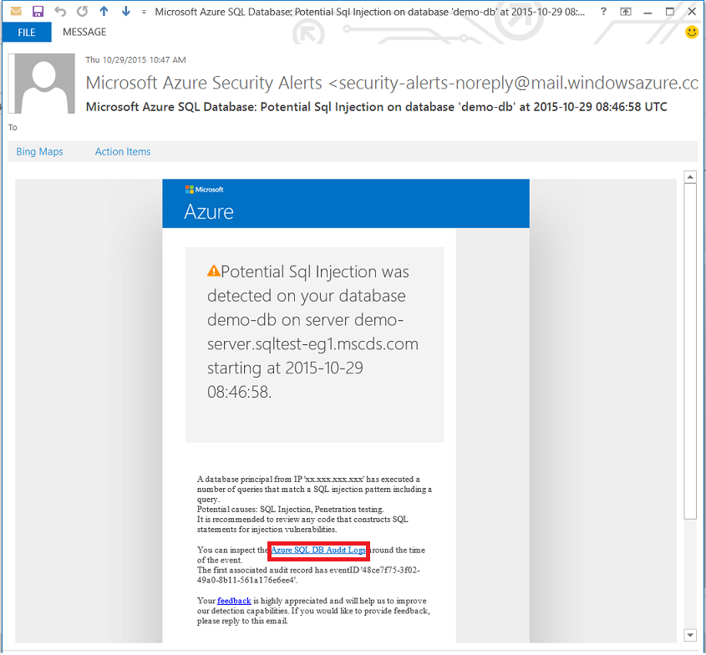
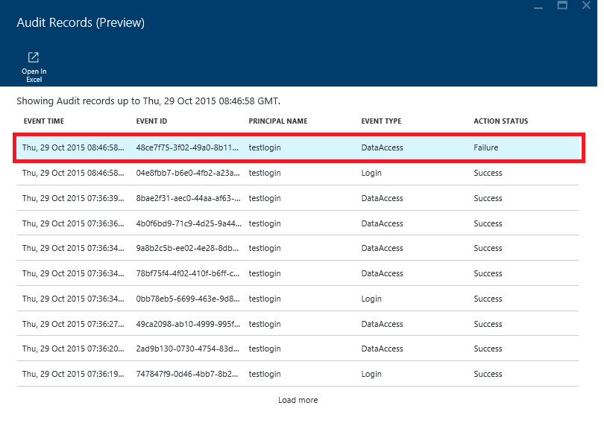
Machine learning based threat detection

Slide 16
Grow with your needs Machine learning based performance acceleration
SQL Database Advisor
User
User
Automatic Index tuning tailored to each workload
Notes:
Additionally, we are using machine learning to deliver intelligent data services that work for you. For example, with [SQL Database Advisor], we automatically implement, tune and validate indexes to guarantee the most optimal performance. We can use AI to auto-index your data so you don’t have to.
<Transition>: Not only are we making our services smarter and safer for you, we are also building our data services to enable you to build globally scalable applications with extremely low latency.

Slide 17
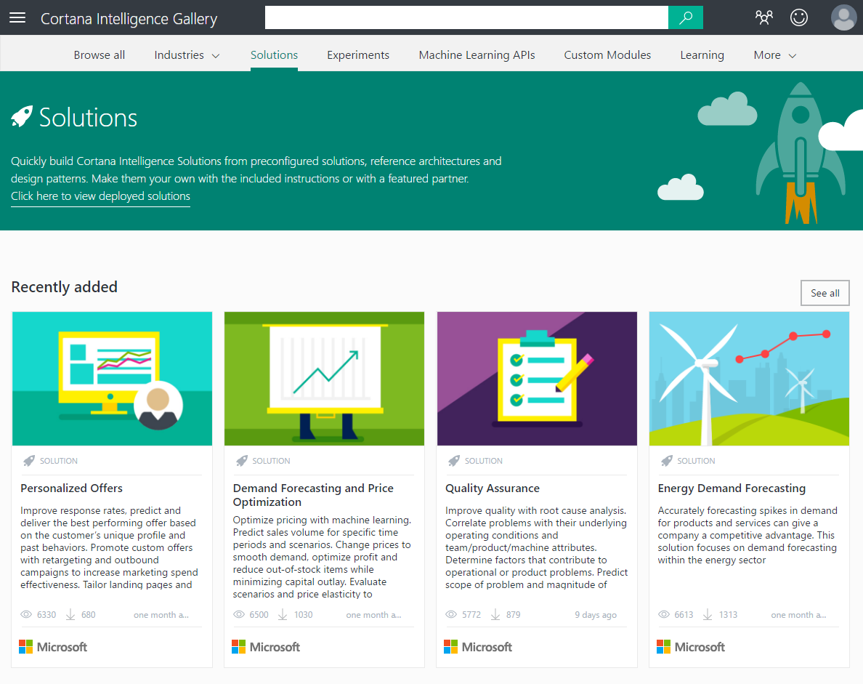
http://aka.ms/cisolutions
Cortana Intelligence solution templates
Reference architecture for common scenarios
Built on best practice design patterns
Automated deployment on your Azure subscription
Customizable for your needs
Supported by a global partner ecosystem
Get started in minutes
Notes:
Cortana Intelligence Solution Templates provide Reference architectures for common ways of combining multiple services on Azure.
Built on best practice design patterns – based on real world customer implementations by our engineering team
Accelerates time to value for an intelligent app – deploy a complex architecture within minutes, instead of days
Flexible & scalable – customizable for your specific needs and backed by a rich partner ecosystem, deployed within your azure subscription where you can bring in other pieces and scale up/down
Three new solution templates are available – Personalization, Demand Forecasting, and Quality Assurance – with many more to come in the future.

Slide 18
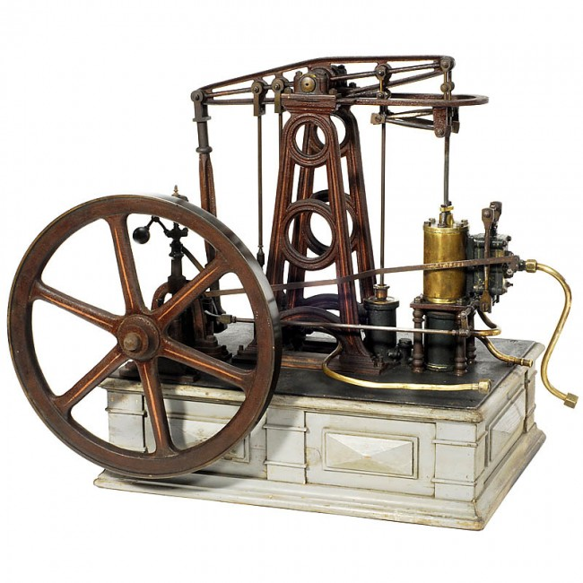



James Watt’s Steam Engine
Intelligent Cloud
Industrial Revolution
Intelligence Revolution
1769 1800 1900 …
Today 2020 2040 ….
Notes:
In 1769 James Watt invented the steam engine.
It kicked off the Industrial revolution that transformed the world in the subsequent decades.
The steam engine of today is the Intelligent Cloud.
It is kicking off the Intelligence Revolution which will transform our world in the next few decades.
It’ll be one of the most exciting times in human history.

Slide 19
Bing 圖片搜尋
語音辨識 API
Entity linking
用戶回饋分析
Bing 新聞搜尋
語音
語音合成 API
自訂語音辨識 (CRIS)
預估
語意
推薦 API
機器學習
Cognitive Services
文本分析
產生縮圖
為應用程式加上人性
拼字檢查
學術知識庫
Web 語言模型
知識
Bing 自動建議
電腦視覺
視覺
表情識別
異常偵測
情緒分析
搜尋
自動標註
Bing 網頁搜尋

Slide 20







Microsoft Cognitive Services
Give your apps a human side
Vision
From faces to feelings, allow your apps to understand images and video
Speech
Hear and speak to your users by filtering noise, identifying speakers, and understanding intent
Language
Process text and learn how to recognize what users want
Knowledge
Tap into rich knowledge amassed from the web, academia, or your own data
Search
Access billions of web pages, images, videos, and news with the power of Bing APIs
Labs
An early look at emerging Cognitive Services technologies: discover, try and give feedback on new technologies before general availability

Slide 21
Microsoft Cognitive Services
Give your apps a human side
Computer Vision
Content Moderator
Emotion
Face
Video Indexer
Custom Vision Service
Bing Speech
Speaker Recognition
Custom Speech Service
Bing Spell Check
Linguistic Analysis
Text Analytics
Translator Text & Speech
Web Language Model
Language Understanding
Academic Knowledge
Entity Linking
Knowledge Exploration
Recommendations
QnA Maker
Custom Decision Service
Bing Autosuggest
Bing Image Search
Bing News Search
Bing Video Search
Bing Web Search
Bing Entity Search
Bing Custom Search
Project Prague (gesture)
Project Cuzco (events)
Project Johannesburg (routing)
Project Nanjing (isochrones)
Project Abu Dhabi (distance matrix)
Project Wollongong (location)
Vision
Speech
Language
Knowledge
Search
Labs

Slide 22
Microsoft Cognitive Services
Give your apps a human side
Vision
Speech
Language
Knowledge
Search
Labs
Computer Vision
Content Moderator
Emotion
Face
Video Indexer
Bing Speech
Speaker Recognition
Bing Spell Check
Linguistic Analysis
Text Analytics
Translator Text & Speech
Web Language Model
Academic Knowledge
Entity Linking
Knowledge Exploration
Recommendations
QnA Maker
Bing Autosuggest
Bing Image Search
Bing News Search
Bing Video Search
Bing Web Search
Bing Entity Search
Project Prague (gesture)
Project Cuzco (events)
Project Johannesburg (routing)
Project Nanjing (isochrones)
Project Abu Dhabi (distance matrix)
Project Wollongong (location)
CUSTOMIZATION
Custom Vision Service
Custom Speech Service
Language Understanding
Custom Decision Service
Bing Custom Search

Slide 23
Microsoft Cognitive Services
Customization
The broadest set of custom AI services available, allowing customers to use their own data with algorithms that are customized for their specific needs.
Vision
Speech
Language
Knowledge
Search
Labs
Customizable web service that learns to recognize specific content in imagery
Fine-tune speech recognition for anyone, anywhere
Teach your apps to understand commands from your users
Create custom experiences with adaptive, contextual decision-making
Create a highly-customized web search experience
Custom Vision Service
Custom Speech Service
Language Understanding
Custom Decision Service
Bing Custom Search

Slide 24
Demo

Slide 25
新一代 Azure Machine Learning Services

Slide 26
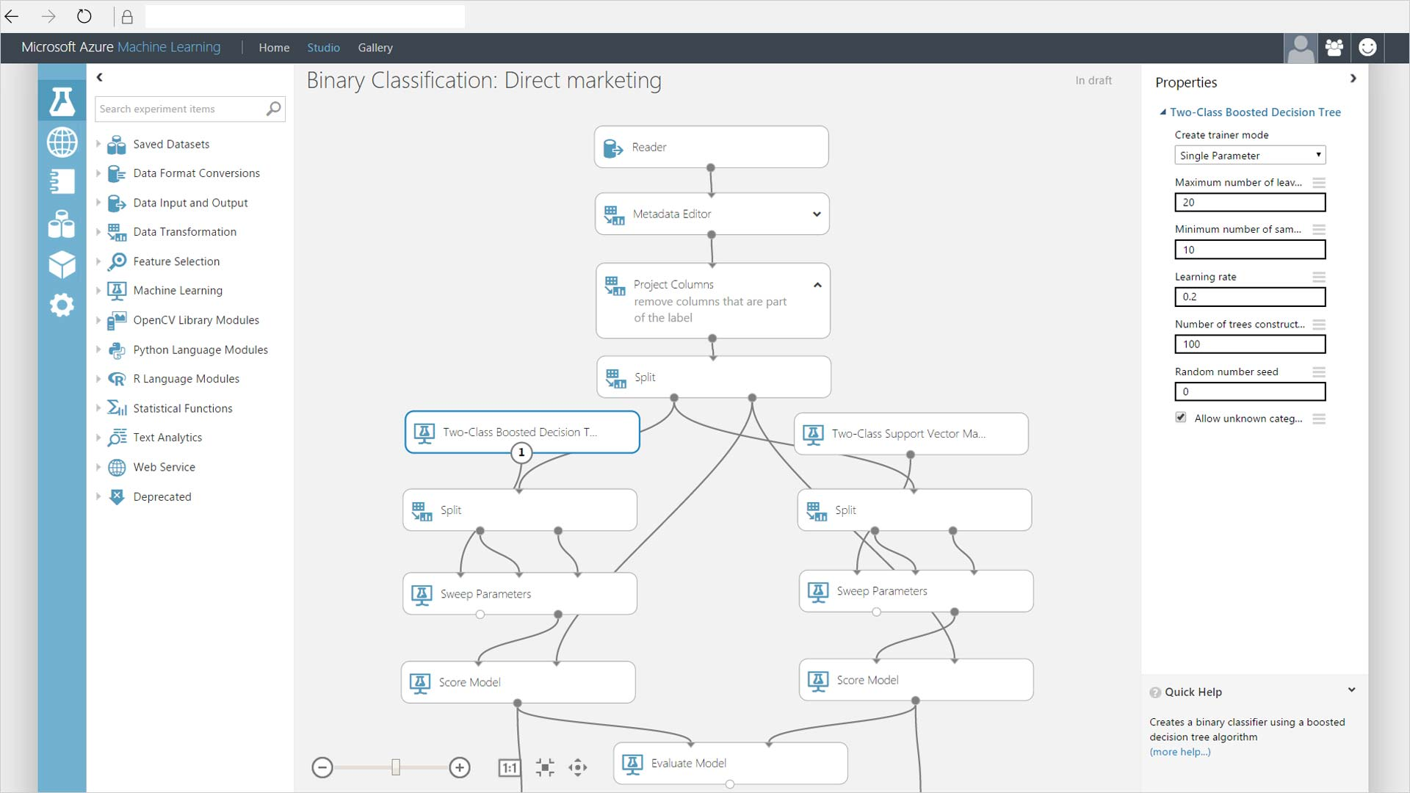
Azure Machine Learning Studio
整合環境
同類最佳演算法
幾分鐘內即可完成佈署
讓資料科學家專注於資料模型的建立，簡單滑鼠拖放之 HTML 5 介面
內建多種最佳演算法。可透過 R 或 Python 自訂演算法
按一下按鈕即可進行模型訓練與模型佈署，直接提供 REST API 供程式呼叫

Slide 27
data science & AI
Key trends
challenges
Accelerating adoption of AI by developers (consuming models)
Rise of hybrid training and scoring scenarios
Push scoring/inference to the event (edge, cloud, on-prem)
Some developers moving into deep learning as non-traditional path to DS / AI dev
Growth of diverse hardware arms race across all form factors (CPU / GPU / FPGA / ASIC / device)
Data prep
Model deployment & management
Model lineage & auditing
Explain-ability

Slide 28


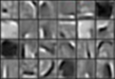
Identifying Snow Leopards Computer vision and classification on Spark
Image
Image features
Decision tree or logistic regression
Gap
Class 1
Class 1
snow leopard?
34-layer residual
Spark ML classifier
image
pool, /2
7x7 conv, 64, /2
3x3 conv, 64
3x3 conv, 64
3x3 conv, 64
3x3 conv, 64
3x3 conv, 64
3x3 conv, 64
3x3 conv, 128, /2
3x3 conv, 128
3x3 conv, 128
3x3 conv, 128
3x3 conv, 128
3x3 conv, 128
3x3 conv, 128
3x3 conv, 128
3x3 conv, 256, /2
3x3 conv, 256
3x3 conv, 256
3x3 conv, 256
3x3 conv, 256
3x3 conv, 256
3x3 conv, 256
3x3 conv, 256
3x3 conv, 256
3x3 conv, 256
3x3 conv, 256
3x3 conv, 256
Deep neural network
Spark ML classifier

Slide 29
The AI Development lifecycle
.
LOB
CRM
INGEST
STORE
PREP & TRAIN
MODEL & SERVE
Graph
On-prem
Cloud
Image
Data orchestration and monitoring
Data lake and storage
Hadoop/Spark/SQL and ML
Social
IoT
Apps + insights
IoT
Cloud
Azure Machine Learning

Slide 30
New Capabilities
AZURE MACHINE LEARNING SERVICES
TRAIN & DEPLOY OPTIONS
Spark
SQL Server
Virtual machines
GPUs
Container services
AZURE
Experimentation and Model Management Services
ON-PREMISES
SQL Server
Machine Learning Server
Notebooks
IDEs
Azure Machine Learning Workbench
VS Code Tools for AI
EDGE
Azure IoT Edge

Slide 31
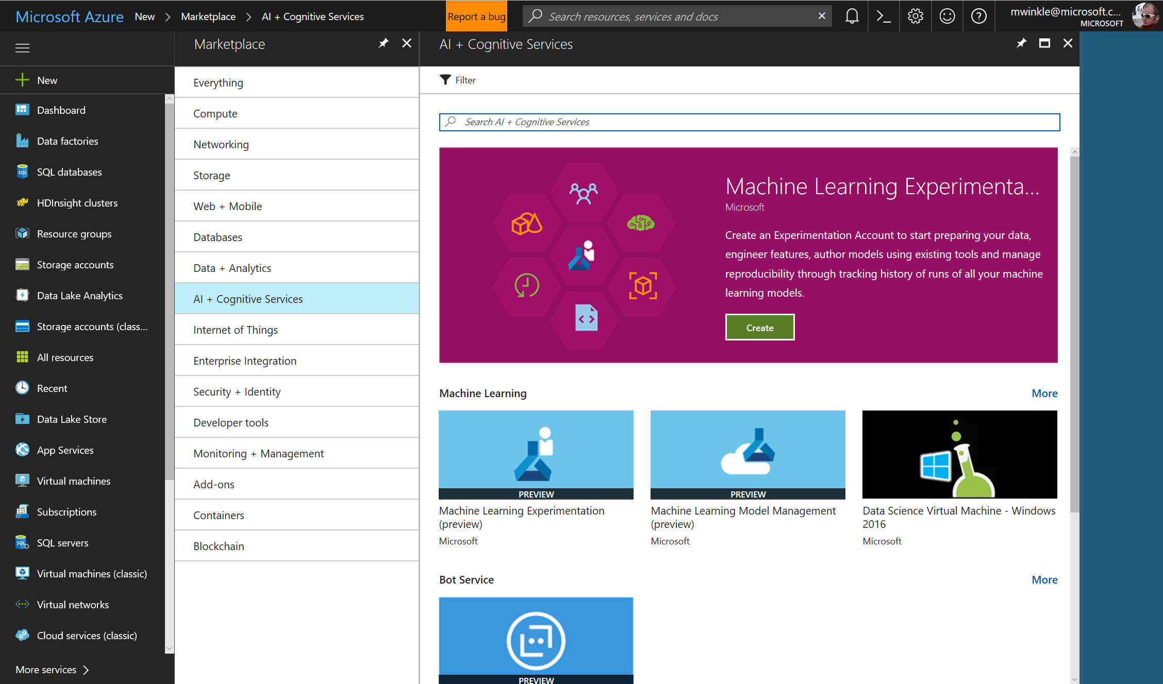

Slide 32

Experiment Everywhere
Local machine
Scale up to DSVM
Command line tools
Scale out with Spark on HDInsight
IDEs
Notebooks in Workbench
AZURE ML
EXPERIMENTATION
VS Code Tools for AI
Azure Batch AI (Coming Soon)
ML Server

Slide 33

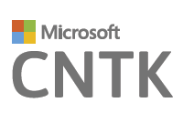
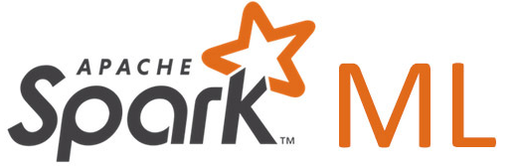








Experimentation service
Manage project dependencies
Manage training jobs locally, scaled-up or scaled-out
Git based checkpointing and version control
Service side capture of run metrics, output logs and models
Use your favorite IDE, and any framework
Use any framework or library
Use any tool
Use the most popular innovations

Slide 34
Deploy Everywhere
Single node deployment (cloud/on-prem)
Azure Container Service
Azure IoT Edge
AZURE ML
MODEL MANAGEMENT
DOCKER
Microsoft ML Server
Spark clusters
SQL Server

Slide 35
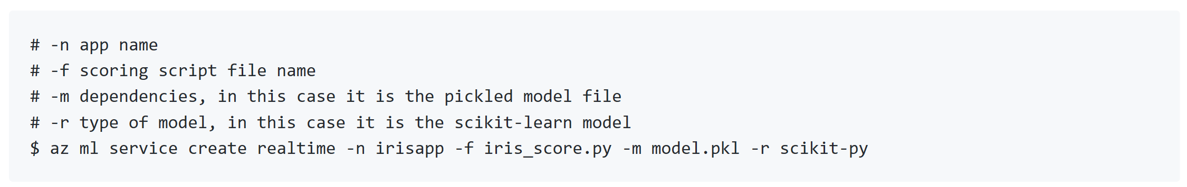
Manage models
Deployment and management of models as HTTP services
Container-based hosting of real time and batch processing
Management and monitoring through Azure Application Insights
First class support for SparkML, Python, Cognitive Toolkit, TF, R, extensible to support others (Caffe, MXnet)
Service authoring in Python

Slide 36
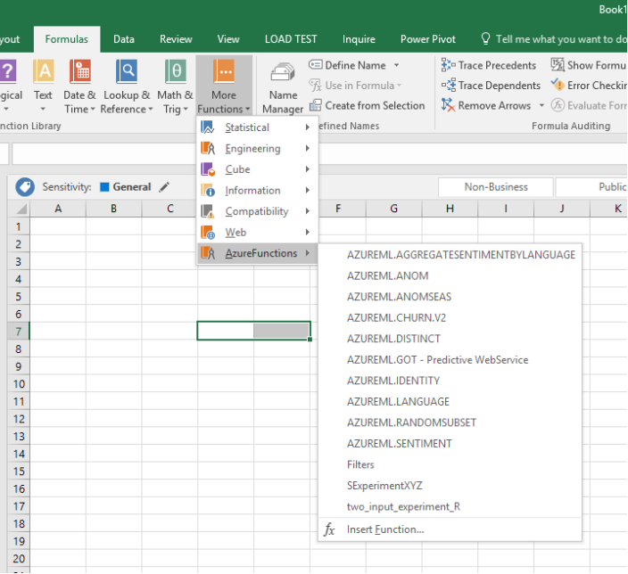
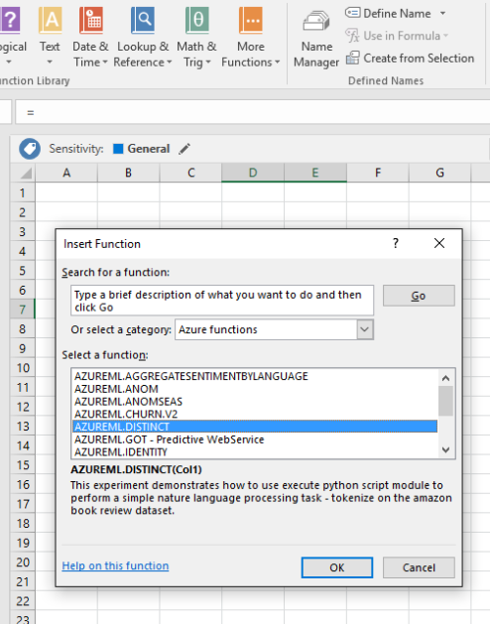
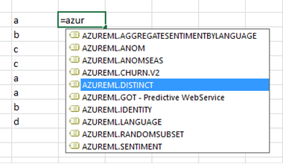
AI Powered Spreadsheets
Any model published through Model Management can be called from Excel

Slide 37
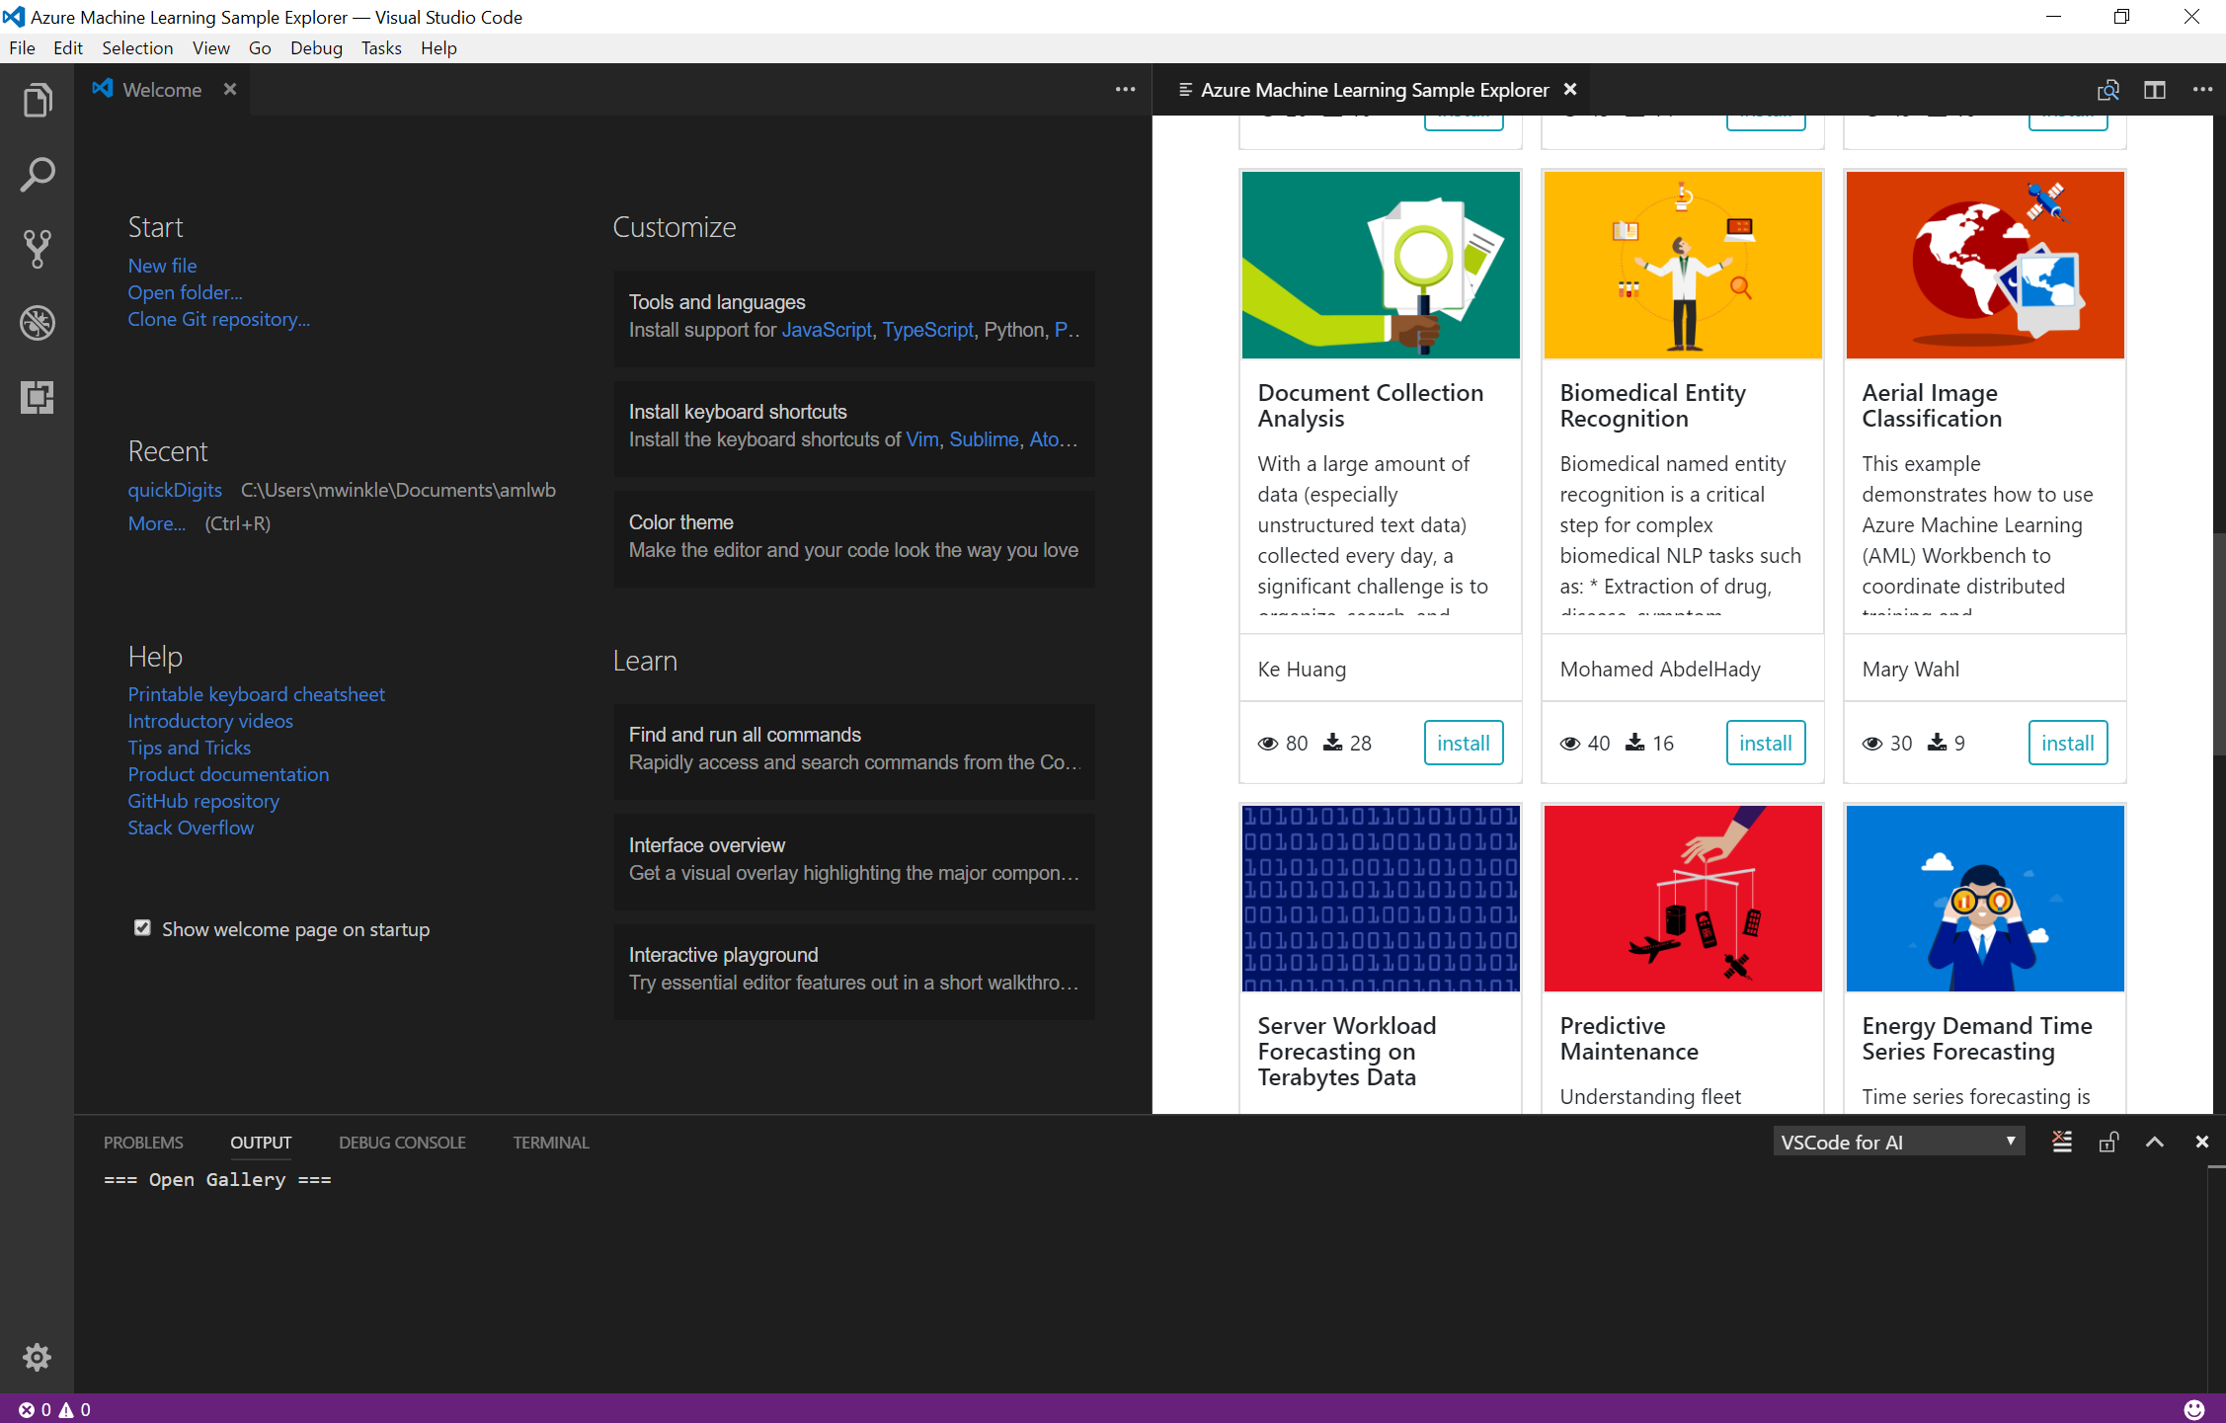
VS Code Tools for AI
VS Code extension with deep integration to Azure ML
End to end development environment, from new project through training
Support for remote training
Job management
On top of all of the goodness of VS Code (Python, Jupyter, Git, etc)

Slide 38
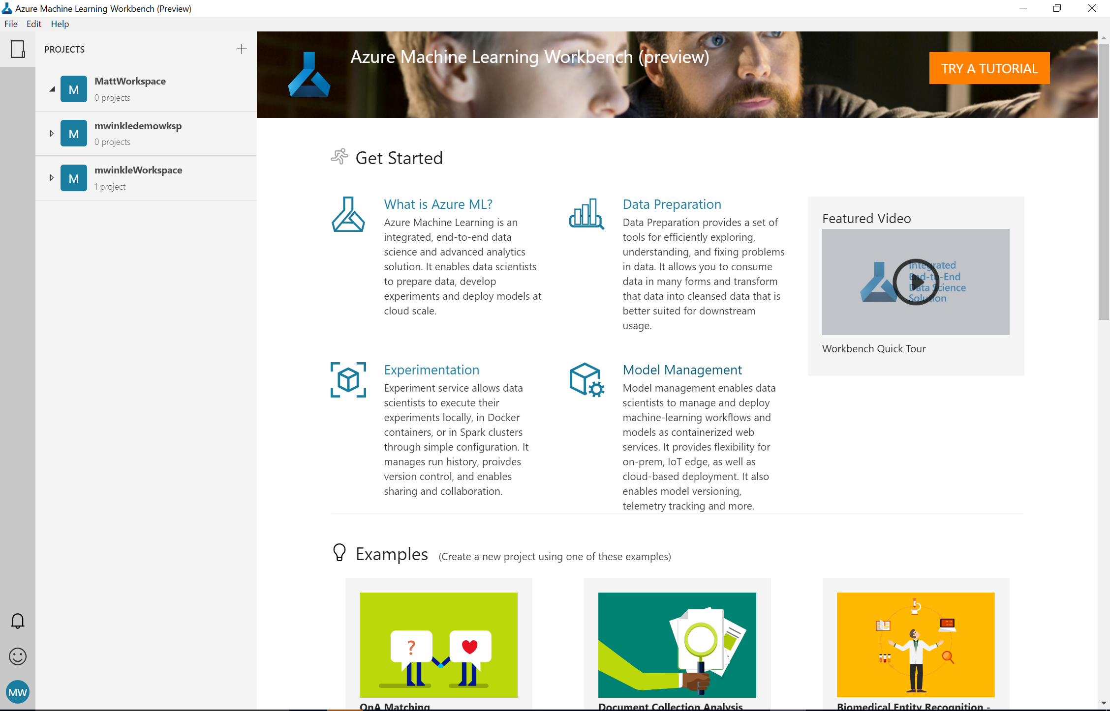
What Is It?
Windows and Mac based companion for AI development
Full environment set up (Python, Jupyter, etc)
Embedded notebooks
Run History and Comparison experience
New data wrangling tools

Slide 39
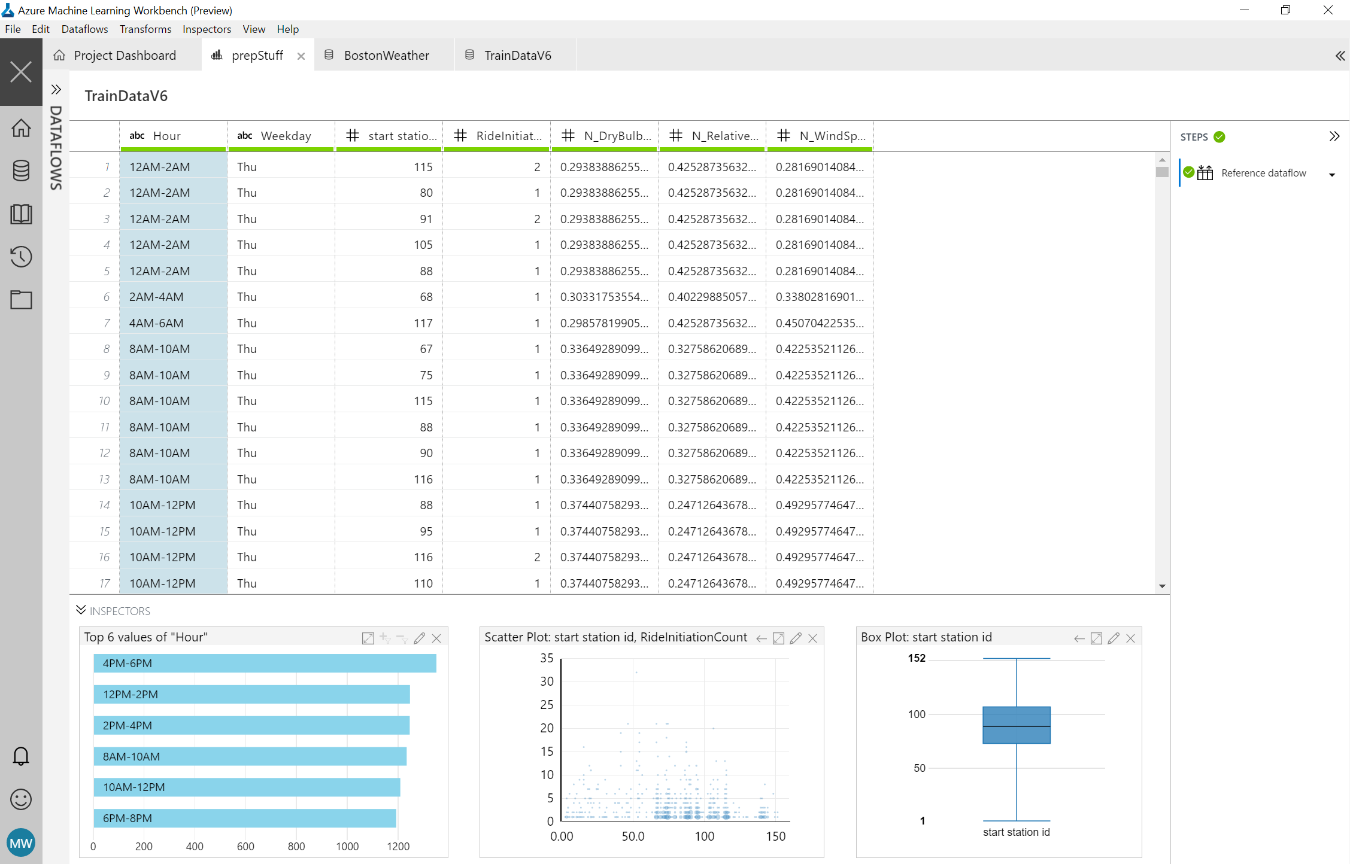
AI Powered Data Wrangling
Rapidly sample, understand, and prep data
Leverage PROSE and more for intelligent, data prep by example
Extend/customize transforms and featurization through Python
Generate Python and Pyspark for execution at scale

Slide 40
Demo Azure Machine Learning Walkthrough

Slide 41
Machine Learning & AI Portfolio When to use what?
Microsoft ML & AI products
Build your own or consume pre-trained models?
Build your own
Consume
Azure Machine Learning
Cognitive services, bots
Which experience do you want?
Code first
Visual tooling
Deployment target
(On-prem) ML Server
(cloud)
AML services (Preview)
(cloud)
AML Studio
What engine(s) do you want to use?
On-prem Hadoop
SQL Server
SQL Server
Spark
Hadoop
Azure Batch
DSVM
Azure Container Service

Slide 42
Microsoft Cognitive Toolkit (CNTK)

Slide 43
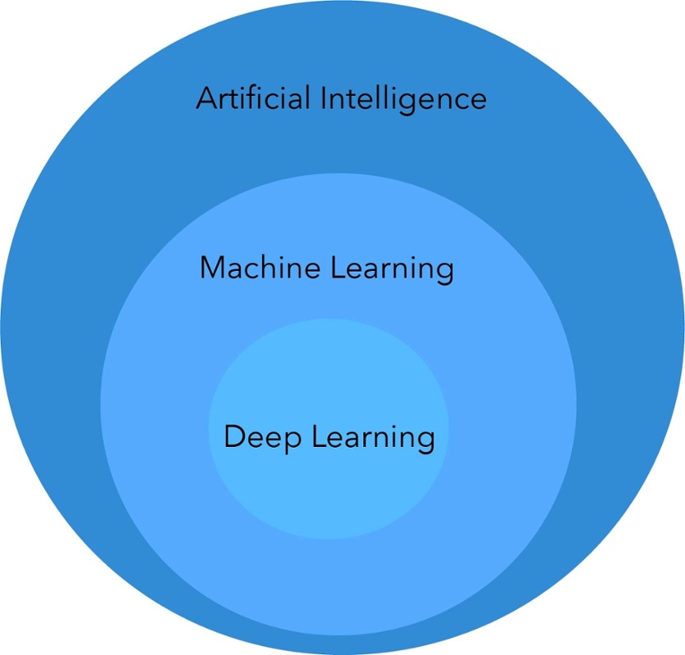
AI vs ML vs DL

Slide 44

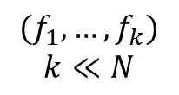
Machine Learning
N X N
SVM
Logistic Regression
Random Forest
Decision Trees
Ensemble
$$(f_{1},…,f_{k})$$
$$k≪N$$
Chhaya

Slide 45
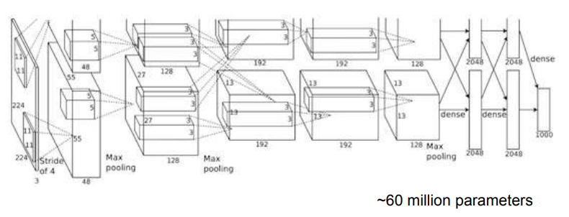
End-to-End Deep Learning
N X N
Chhaya
Same with ML: Data cleaning, Underfit/Overfit, cost function, hyperparameters

Slide 46
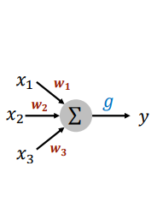
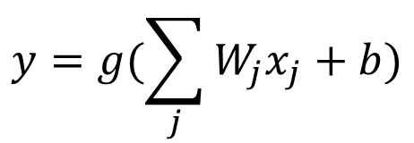
Artificial Neuron (unit)
Output of the unit
inputs of the unit
$$y=g(\sum_{j}{W_{j}x_{j}}+b)$$
Activation function
Linear weights
Bias unit

Slide 47
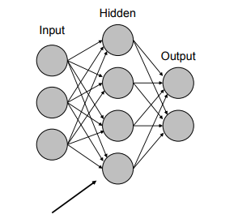
Network of Artificial Neurons
Affine layer: Linear + Bias + Activation

Slide 48

Deep Convolutional Neural Networks
55
INPUT
27
13
dense
dense
dense
OUTPUT
13
13
11
5
3
3
3
“Dog”
11
27
13
3
13
13
Input Image (RGB)
5
3
3
224
55
384
384
256
1000
256
Max
pooling
Max pooling
Max pooling
4096
4096
224
Stride of 4
96
3
3-D Convolution and Max Pooling
Dense Layers
* Krizhevsky et al, NIPS’12

Slide 49
Revolution of depth
AlexNet, 8 layers
(ILSVRC 2012)
VGG, 19 layers
(ILSVRC 2014)
GoogleNet, 22 layers
(ILSVRC 2014)
ILSVRC (ImageNet Large Scale Visual Recognition Challenge)

Slide 50
Revolution of depth
AlexNet, 8 layers
(ILSVRC 2012)
VGG, 19 layers
(ILSVRC 2014)
ResNet, 152 layers
(ILSVRC 2015)
Microsoft
ILSVRC (ImageNet Large Scale Visual Recognition Challenge)

Slide 51
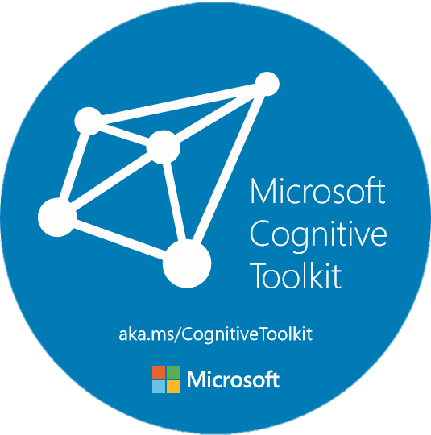
Microsoft Cognitive Toolkit (CNTK)
Microsoft’s open-source deep-learning toolkit
https://github.com/Microsoft/CNTK
Created by Microsoft Speech researchers in 2012,
“Computational Network Toolkit”
Open sourced on GitHub since Jan 2016 (MIT license)
12,000+ GitHub stars
Third among all DL toolkits
140+ contributors from MIT, Stanford, Nvidia, Intel, and many others

Slide 52
Microsoft Cognitive Toolkit (CNTK)
Runs over 80% Microsoft internal DL workload
Cortana
HoloLens
Bing and Bing Ads
Skype Translator
Windows
Office
Microsoft Cognitive Services
Microsoft Research
Internal == External

Slide 53
Microsoft Cognitive Toolkit (CNTK)
1st-class on Linux and Windows
Docker support
Rich API support
Mostly implemented in C++ (train and eval)
Low level + high level Python API
R and C# API for train and eval
UWP, Java and Spark support
Built-in readers for distributed learning
Keras backend support (Beta)
Model compression (Fast binarized evaluation)
Latest version: v2.2 (Sep. 15, 2017)

Slide 54
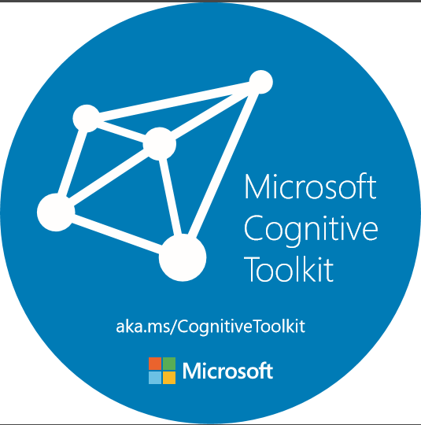
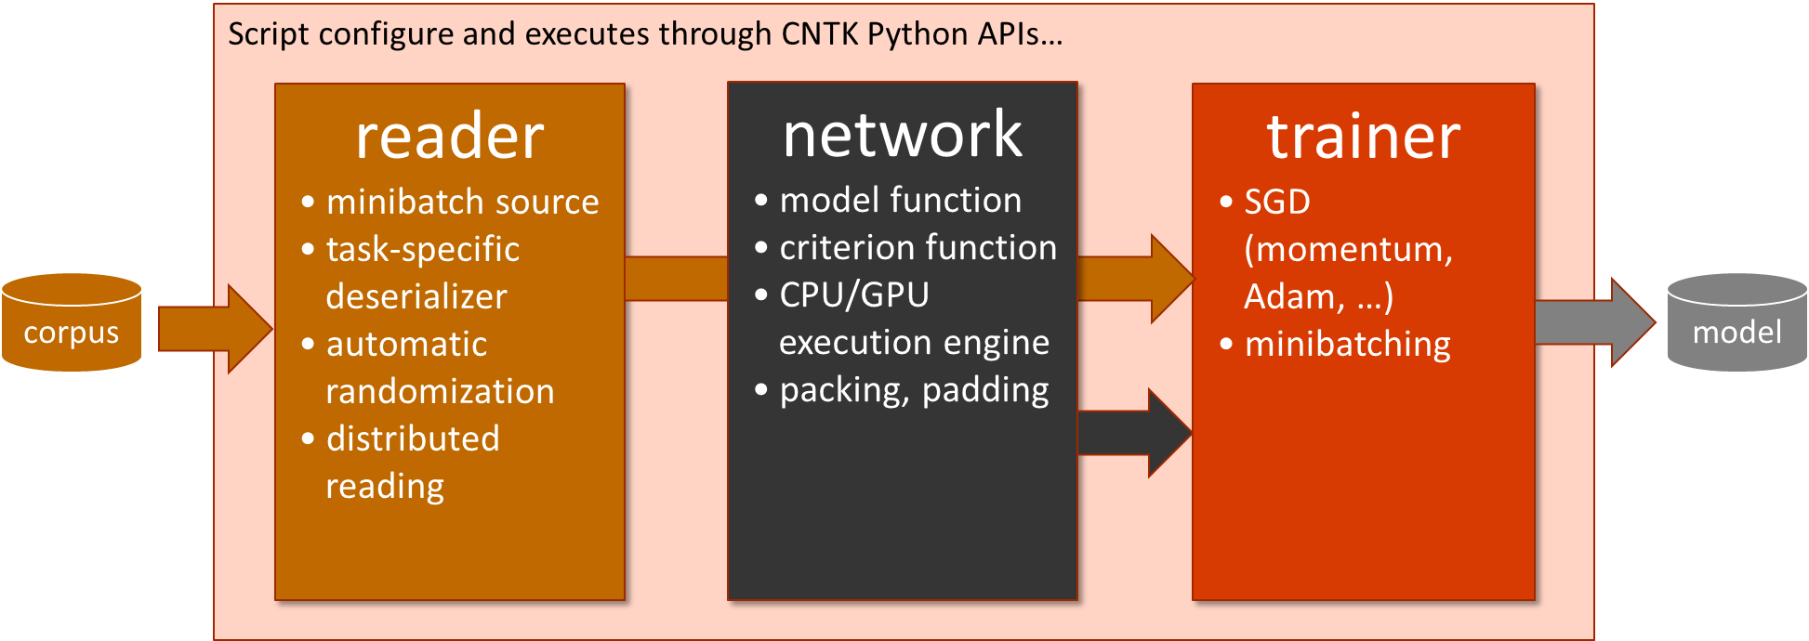
As Easy as 1-2-3
from cntk import *
# reader
def create_reader(path, is_training):
...
# network
def create_model_function():
...
def create_criterion_function(model):
...
# trainer (and evaluator)
def train(reader, model):
...
def evaluate(reader, model):
...
# main function
model = create_model_function()
reader = create_reader(..., is_training=True)
train(reader, model)
reader = create_reader(..., is_training=False)
evaluate(reader, model)

Slide 55
Walkthrough: MNIST with CNTK

Slide 56
microsoft.com/ai

